Slide 1
HEALTHCARE CHATBOT
TEAM _ NO : 12
TEAM MEMBERS:
1) 2019103501 – ABINUS MERCY A
2) 2019103537 – KAVISHREE S
3) 2019103549 – NIRUTHIYA SHRI P
Guided by :
Dr. A.R. ARUNARANI
Teaching Fellow
Department of Computer Science and Engineering
Anna University

Slide 2
INTRODUCTION :
The famous proverb “Health is Wealth” has not long forgotten. As health is considered the most valuable and precious for every living Today’s people are busy with their works at home, office and more addicted to Internet. They avoid going hospitals for small problems. Those small problems may become major problem.
To avoid this, we have come up with a chatbot which will help the users to predict their possible disease in an easy way.

Slide 3
This system application uses question and answer protocol within the style of chatbot to answer user queries.The response to the question is replied supported the user question.The significant keywords are fetched from the sentence through which we can identify symptoms of explicit illness.
This system is developed to scale back the tending price and time of the users because it is not potential for the users to go to the doctors once in a real time required.

Slide 4
OBJECTIVE :
In this project, we create a healthcare chatbot system using Python and NLT that can diagnosis the disease and provide basic information about the disease before consulting a doctor.
This real time chat system is simple and interactive. We crafted this system in such a way to detect disease according to the symptoms.
This chatbot’s true well-being is to promote the general public by offering sufficient advice in terms of a great and balanced life.

Slide 5
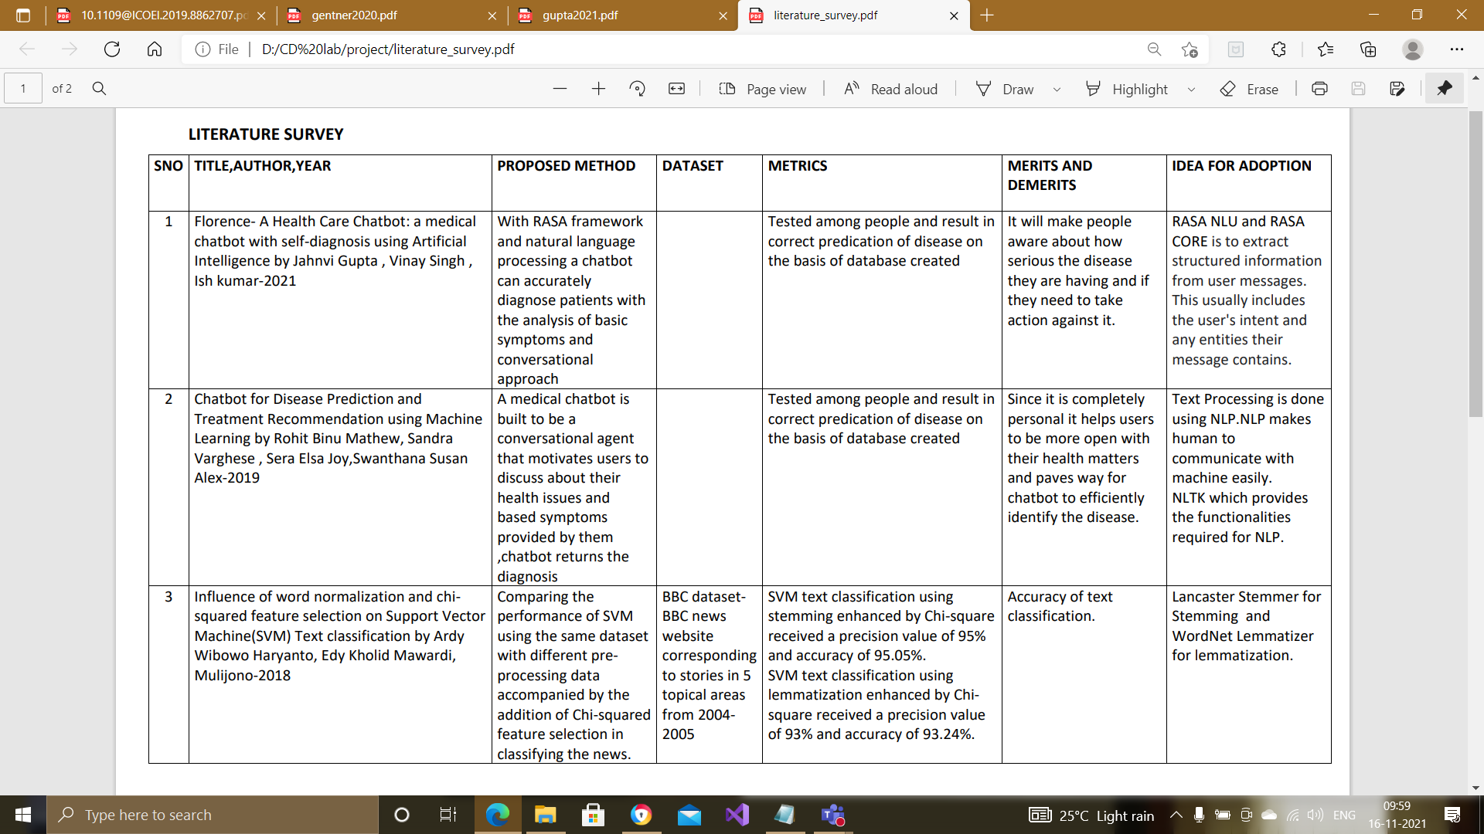
Literature Survey

Slide 6
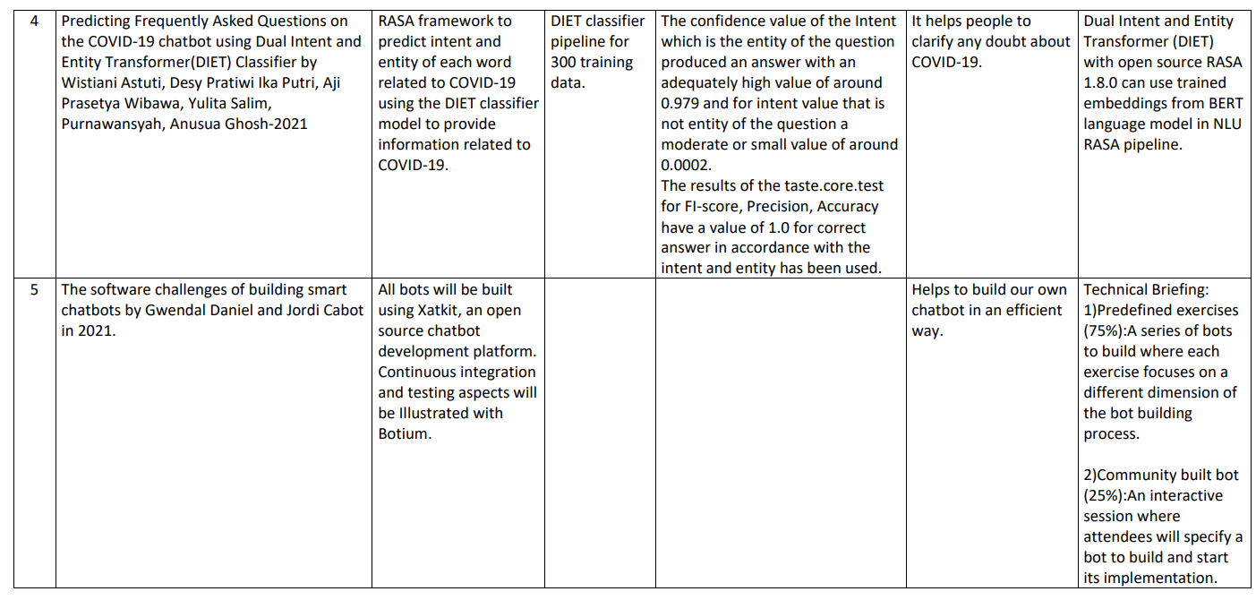

Slide 7
SUMMARY OF ISSUES
One of the key concerns in the use of AI chatbots in healthcare is user privacy. The users of such software products might be reluctant to share their personal information with bots.User privacy is a critical issue when it comes to any type of AI implementation, and sharing information about one's medical conditions with a chatbot seems less reliable than sharing the same information with a human doctor.
AI-enabled chatbots are prone to errors, which eventually leads to patient injury or other significant problems
Chatbot using nltk might misunderstood some spellings leading to wrong consultation

Slide 8
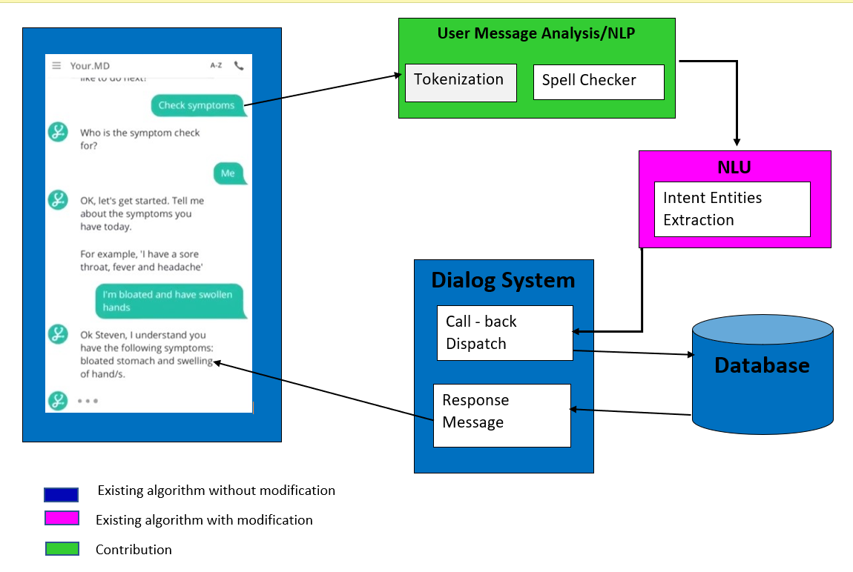
Detailed Architecture

Slide 9
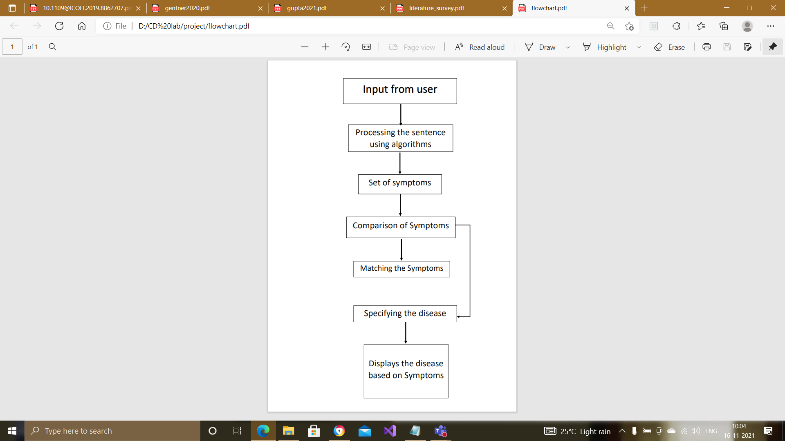
FlowChart Diagram for Chatbot

Slide 10
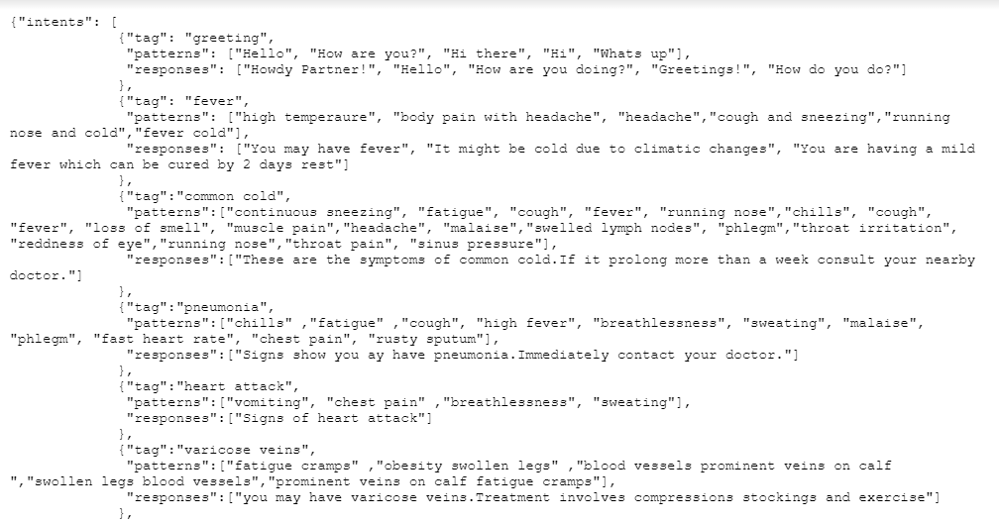
Input file

Slide 11
MODULES USED:
Creating separate lists of all patterns and tags
Creating training data
Creating deep learning model
Cleaning text
Creating bag of words
Predicting classes
Getting response and Running chatbot

Slide 12
Module 1 - Creating separate lists of all patterns and tags
We have given input as tags with their respective patterns and responses
So,First we have to separate them.
Create a vocabulary of all of the words used in the patterns (recall the patterns are the queries posed by the user)
Create a list of the classes — This is simply the tags of each intent
Create a list of all the patterns within the intents file
Create a list of all the associated tags to go with each pattern in the intents file

Slide 13
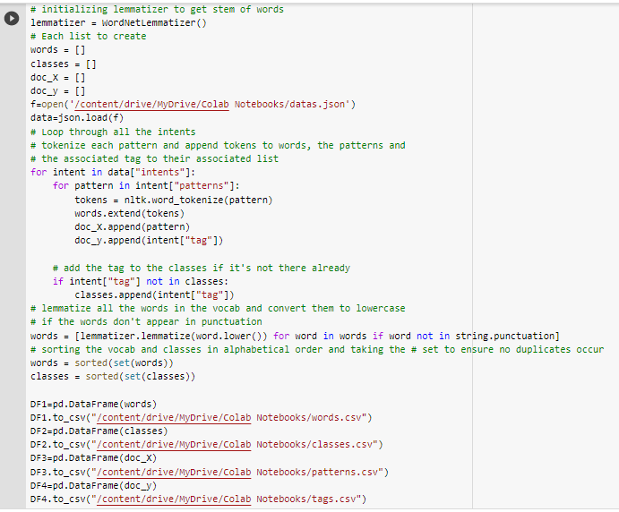

Slide 14
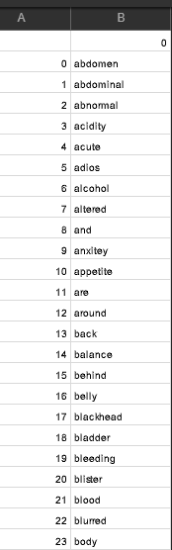
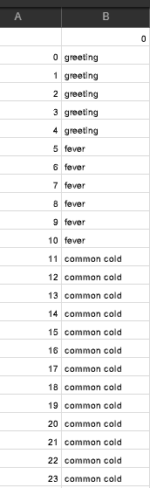
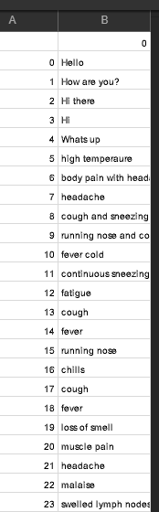
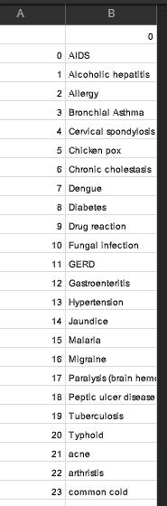
Example: WORDS: TAGS: PATTERNS: CLASSES:

Slide 15
Module 2 - Creating training data
Neural Networks expect numerical values, and not words, to be fed into them, therefore, we first have to process our data so that a neural network could read what we are doing.
In order to convert our data to numerical values, we are going to leverage a technique called bag of words.

Slide 16
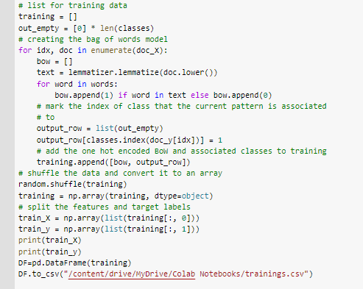

Slide 17
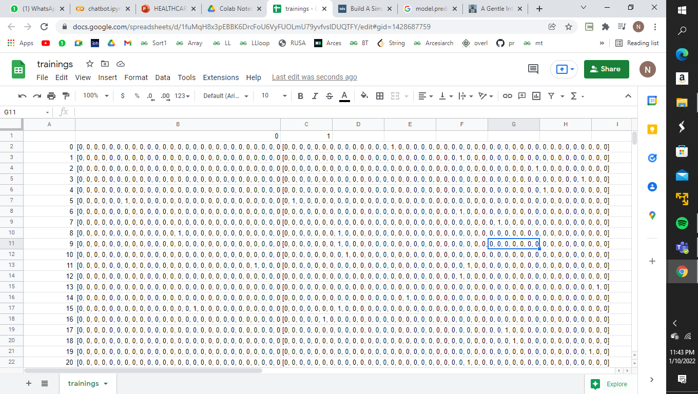
Training data that will be used for prediction

Slide 18
Module 3 – Creating deep learning model
With our data converted into a numerical format, we can now build a Neural Network model that we are going to feed our training data into. The idea is that the model will look at the features and predict the tag associated with the features then will select an appropriate response from that tag.

Slide 19
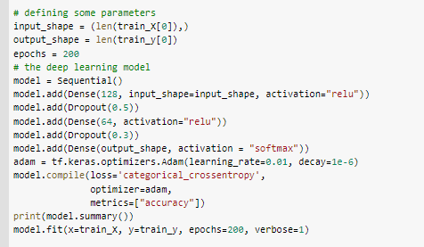

Slide 20
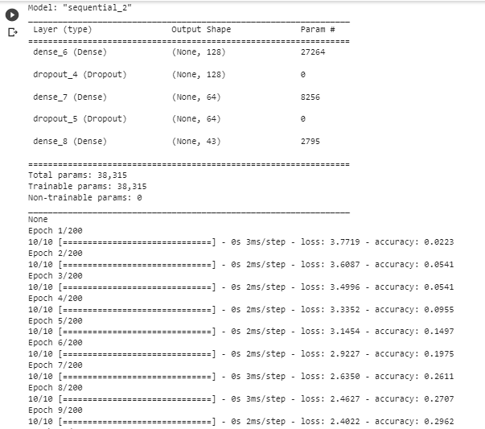

Slide 21
Module 4 – Cleaning text
This is about preprocessing the input entered by the user.
First we are tokenizing the words and then applying lemmatization technique to find the stem of words

Slide 22
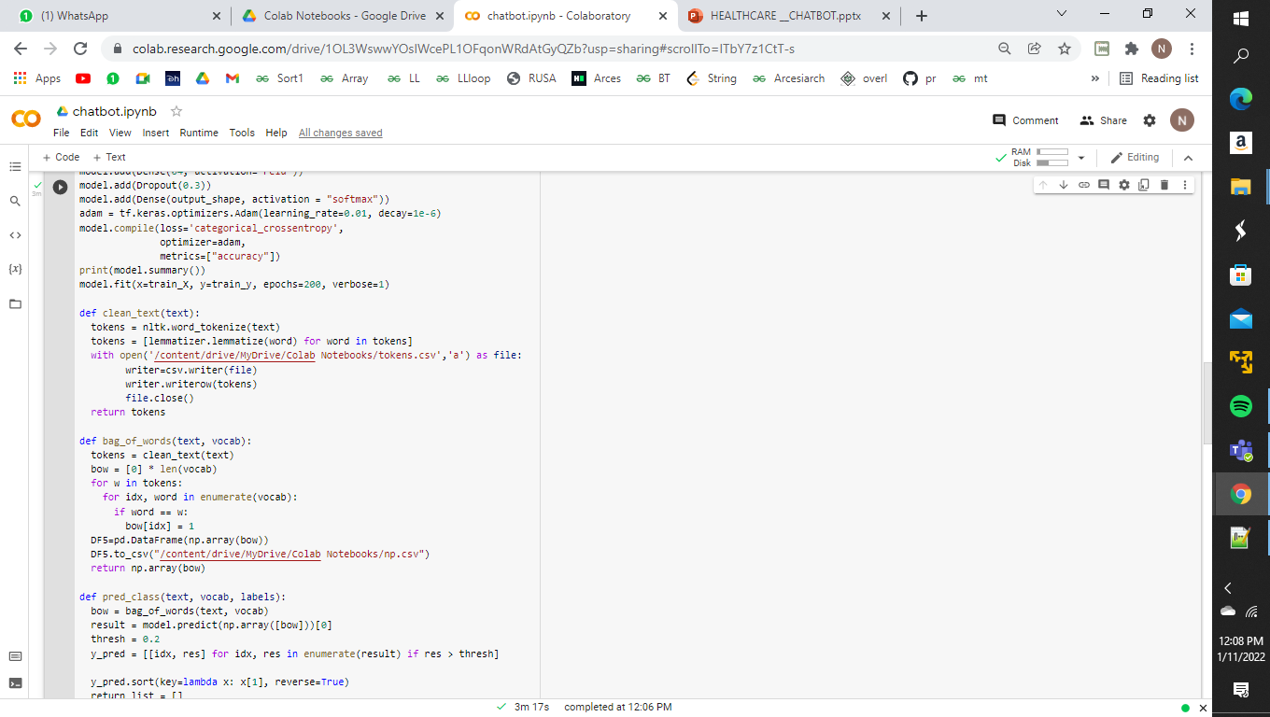
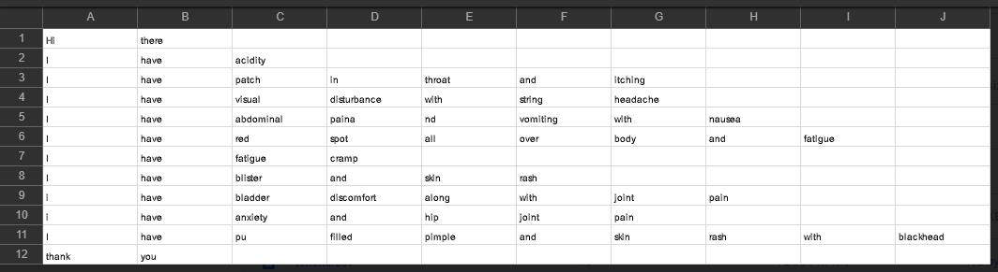
Tokens.csv

Slide 23
Module 5 – Bag of words
A bag-of-words model, or BoW for short, is a way of extracting features from text for use in modeling, such as with machine learning algorithms.
The approach is very simple and flexible, and can be used in a myriad of ways for extracting features from documents.
A bag-of-words is a representation of text that describes the occurrence of words within a document. It involves two things:
*A vocabulary of known words.
*A measure of the presence of known words.
Two algorithms are used here:
A)N-gram algorithm
- N-gram is a neighboring sequence of n-items from a given sample
of text. N-items means we can have two items, three items and so on. So, it is a
contiguous sequence of some items.it helped to predicting the next words in a sentence
B)TF_IDF algorithm
- This approach to scoring is called Term Frequency – Inverse
Document Frequency, or TF-IDF for short, where:
1) Term Frequency: is a scoring of the frequency of the word in the current document.
2)Inverse Document Frequency: is a scoring of how rare the word is
across documents.

Slide 24
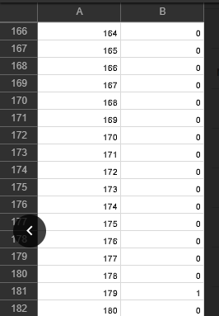
Bag of words.csv

Slide 25
Module 6 – Predicting classes
Python predict() function enables us to predict the labels of the data values on the basis of the trained model.
The predict() function accepts only a single argument which is usually the data to be tested.
It returns the labels of the data passed as argument based upon the learned or trained data obtained from the model.
Thus, the predict() function works on top of the trained model and makes use of the learned label to map and predict the labels for the data to be tested.

Slide 26
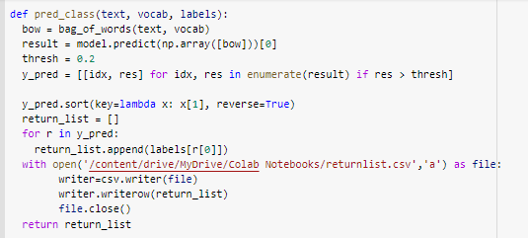
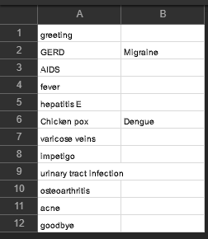
Predicted classes.csv

Slide 27
Module 7 - Getting response and running the chatbot
Create a while loop that allows a user to input some query which is then cleaned, meaning we take the tokens and lemmatize each word. After that, we convert our text to numeric values using our bag of words model and make a prediction of what tag in our intents the features best represent. From there, we would take a random response from our responses within that intents tag and use that to respond to the query.
So when a chatbot is running , it gets the user input and predicts the class where it belongs and then compare them and writes the result as reply of chatbot.

Slide 28
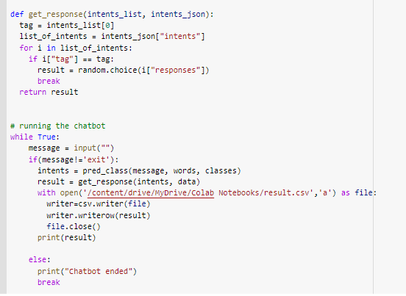

Slide 29
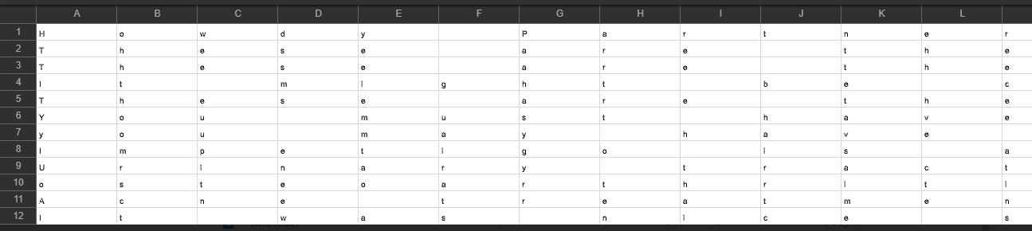
Result.csv
The result to respective input of the user is saved into csv file letter by letter in each column inclusing the white space.
This is because when the result is processed it is read and printed letter by letter in the chatbot which results in this.

Slide 30
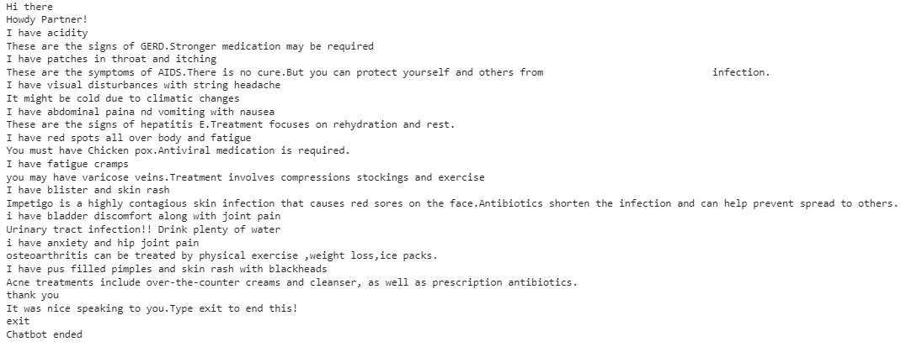
Chatbot functioning

Slide 31
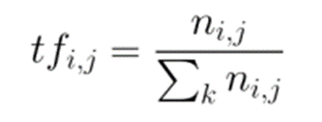
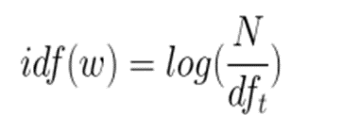
Evaluation Formulae
¨Term frequency ( tf ) Generally, when building a model with the goal of understanding text, you’ll see all of stop words being removed. Another approach is to score the relative importance of words using TF-IDF. The number of times a word seems during a sentence divided by the entire number of words within the sentence. Each sentence has its own term frequency.
¨The log of the number of documents divided by the number of documents that contain the word. Inverse data frequency determines the weight of unique words across all documents in the corpus.
N-gram is a neighboring sequence of n-items from a given sample of text
N-items means we can have two items, three items and so on.
So, it is a contiguous sequence of some items.
It helped to predicting the next word in a sentence.
Things will be characters, words, sentences.
N = sequence of some items

Slide 32
References
[1]. S. Divya, Indumathi, S. Ishwarya, M.Priyasankari, S.Kalpanadevi | A Self-Diagnosis Medical Chatbot Using Artificial Intelligence | Institute of Electrical and Engineers June 2019
[2]. Rohit Binu Mathew, Sandra Varghese, Sera Elsa Joy, Swanthana Susan Alex | Published 2019 | Computer Science - 3rd International Conference on Trends in Electronics and
Informatics (ICOEI)
[3]. D. Madhu, C. Jain, Elmy Sebastain, Shinoy Shaji, A. Ajayakumar| Published 2017- Medicine International Conference on Inventive Communication and Computational Technologies
(ICICCT)
[4]. hifa Ghare, Sabreen Shaikh, Tasmia Bano Shaikh and Habib Fakih Awab | Self-Diagnosis Medical Chat-Bot Using Artificial
Intelligence || EasyChair Preprint no. 2736

Slide 33
[5]. Pu Han , Si Shen , Dongbo Wang , Yanyun Liu, “The influence of
word normalization in English document clustering”, 2012 IEEE
International Conference on Computer Science and Automation
Engineering (CSAE). doi:10.1109/csae.2012.6272740
[6]. S. Anil Kumar, C. Vamsi Krishna, P. Nikhila Reddy, B. Rohith
Kumar Reddy, I. Jeena Jacob. (2020) | Self-Diagnosing Health
Care Chatbot using Machine Learning | International Journal of
Advanced Science and Technology, 29(05), 9323-9330
[7]. A. Eckhardt, C. Maier, and R. Buettner, “The Influence of Pressure to
Perform and Experience on Changing Perceptions and User
Performance: A Multi-Method Experimental Analysis,” in ICIS-33
Proc., paper 70, 2012.

Slide 34
THANK YOU

